Slide 1
Version Control with Git and GitHub
BSA Student Faculty Seminar
May 30, 2019
Sarah V. Leavitt

Slide 2
Do you get frustrated by…
Changing your code and then realizing you were right the first time?
Having many different saved versions of the same program?
Having code cluttered with portions you aren’t using but don’t want to lose?
Moving programs between your computer and SCC?
Trying to harmonize code from a group project?
Then git is for you!!!

Slide 3
What are git and GitHub?
git is a version control system which allows you to track changes in your files (usually code)
GitHub is a remote host that provides a platform for collaboration through connecting repositories.

Slide 4
ProjectFolder
Program1.R
Program2.R
Program3.R
…
GitHub
Remote host
Your Computer
Your SCC Directory
Joe’s Computer
Karen’s Computer

Slide 5
Disclaimer!
I am by no means a git expert
You cannot learn git in 50 minutes
This talk is meant to explain the very basics and hopefully convince you that learning git is worth your time
Don’t worry if you are confused! The best way to learn is by doing (especially in your own projects)

Slide 6
Key Terms
Repository – the location where all of your files are stored, analogous to a folder or directory (often abbreviated as “repo”)
Snapshot – the state of your files at any given point in time, how git tracks your code history
Commit – the act of creating a snapshot, essentially capturing the state of a file or set of files at a given time
https://codeburst.io/git-good-part-a-e0d826286a2a

Slide 7
Starting Out
Create a GitHub account
Install git on your computer (https://git-scm.com/downloads)
Open git bash on your computer and type
git config --global user.name “GitHub username“
git config --global user.email your_email@example.com
This should be the email you used for your GitHub account
git config --global color.ui true

Slide 8
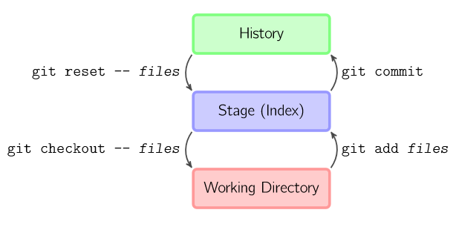
Typical Workflow
Pull
This is the series of steps for basic, daily use of git.
Red steps communicate with the remote host and blue steps are usually performed locally.
To see the current state of files and what needs to be added or committed use:
git status
Change Things
Add
Repeat
Commit
Push
http://marklodato.GitHub.io/visual-git-guide/index-en.html

Slide 9
Typical Workflow
Pull
Pull
Pulls the current state of all files from the host repository (GitHub) onto the current local repository.
Makes sure you are starting your work on the current version of the files.
Code: git pull
Change Things
Add
Repeat
Commit
Push

Slide 10
Typical Workflow
Pull
Change Things
This is when you make any changes to your code or other files.
How many changes you make before you continue to add and commit is up to you.
It is generally good to just make a single change or a few connected changes before continuing.
Change Things
Add
Repeat
Commit
Push

Slide 11
Typical Workflow
Pull
Add
When you make a change to a file git doesn’t track them right away but stores them in your Working Directory
Use add to move the files from the Working Directory to the Staging Environment
The files in the Staging Environment can then be committed to the History (next)
Code: git add <file name>
Add all modified files (doesn’t work for new files)
git add *
Add all files starting with xxx:
git add xxx*
Change Things
Add
Repeat
Commit
Push

Slide 12
Typical Workflow
Pull
Commit
Saves the current state of all added files in your History.
You need to include a commit message that describes the changes you made
You can then go back and access this snapshot of your files at any time
Code: git commit –m “<commit message>”
The above commits all added files; to commit only a certain file use (this actually commits and adds):
git commit <filename> –m “<commit message>”
To commit and add in one step use (doesn’t work with new files):
git commit –a –m “<commit message>”
Change Things
Add
Repeat
Commit
Push

Slide 13
Typical Workflow
Pull
Push
Pushes the current state of all files and the history from the local repository to the host repository (GitHub)
Allows all collaborators (or yourself on a different machine) to access the changes you made
Code: git push
Change Things
Add
Repeat
Commit
Push

Slide 14
Oops!
A great thing about git is being able to discard changes and go back to earlier versions
If you have been working on changes and want to discard them use:
git checkout -- <filenames>
If you want to use certain bits of old code, copy and paste from the history
If you want to revert back to a certain commit use:
git reset
http://marklodato.GitHub.io/visual-git-guide/index-en.html

Slide 15
Integrating with SCC (Interactive Portion)
Here is what we are going to do:
Set up git global options on the SCC
module load git
git config --global user.name “GitHub username“
git config --global user.email your_email@example.com
Create a new repository on GitHub
Clone this repository on to computer and SCC
git clone https://GitHub.com/...
Make changes to the program on your computer
Commit those changes and push to GitHub
Pull changes from GitHub to SCC

Slide 16
So Many Other Features!
Collaborative work – this is a great feature of GitHub that I did not have time to go into (basically pretend the SCC is a different person)
Branches – especially relevant in collaborative work, you can make a branch to experiment with code without changing the main files
Merging – if you have more than one person working a file (or yourself in two places!) you will run into conflicts requiring you to merge files

Slide 17
So Many Other Features! cont.
.gitignore file – add a list of files not to track
SSH – set up SSH so that you do not have to log in continually
Start with local repo – you can make a folder you already have into a git repo (instructions)
R projects – you can use version control right inside of R (see here and here)
git GUI – don’t like the command line? You can use a graphical interface instead.
Private repositories – A repo on GitHub is public, use Bitbucket to host private repos.

Slide 18
How to Really Learn git
git/GitHub guide a minimal tutorial
An Intro to Git and GitHub for Beginners
Git Magic Tutorial
git Good: A Practical Introduction to git and GitHub (In git we trust!)
A Visual Git Reference
Git Cheat Sheet
Code Academy Tutorial

